Slide 1
Machine learning 101

Slide 2
Machine learning
A machine learning algorithm is an algorithm learning to accomplish a task by observing data.
Used on complex tasks where it’s hard to develop algorithms with handcrafted-rules
Exploits patterns in observed data and extract rules automatically

Slide 3
Fields of application
Computer vision
Speech recognition
Financial analysis
Search engines
Ads-targeting
Content suggestion
Self-driving cars
Assistants
etc...

Slide 4
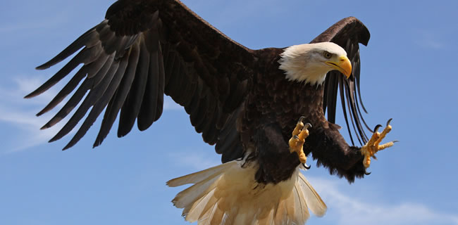
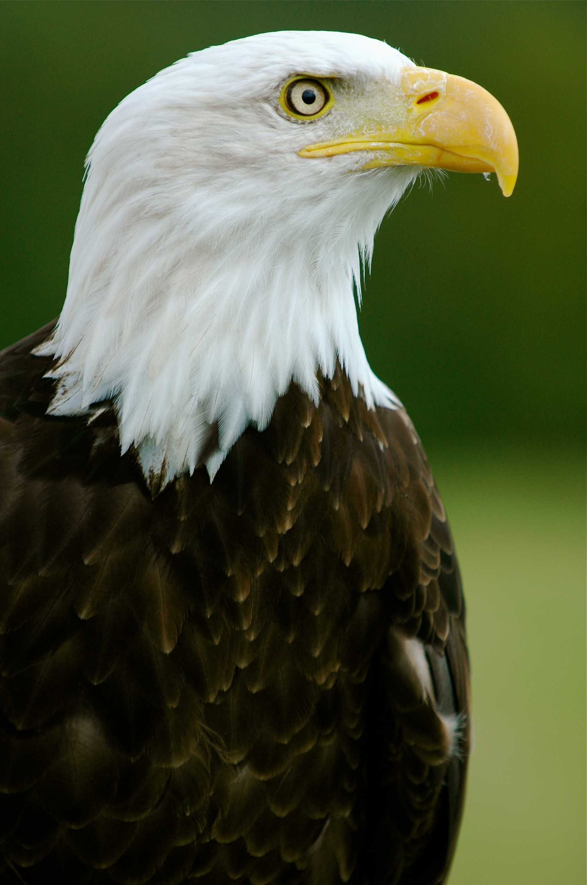
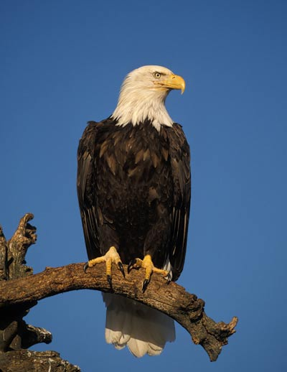

Example : object detection
Big variation in visual features :
Shape
Background
Size / position
Classifying an object in a picture is not an easy task.

Slide 5
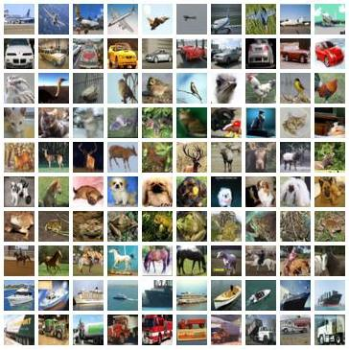
Example : object detection
Learn from annotated corpus of examples (a dataset) to classify unknown images among different object types
Observe images to learn patterns
Lot of data available (i.e: ImageNet dataset)
Very good error rates (< 5% with deep-CNN)

Slide 6
General concepts

Slide 7
Types of ML algorithms
Supervised
Learn a function by observing examples containing the input and the expected output.
Classification
Regression
Unsupervised
Find underlining relations in data by observing the raw data only (without the expected output).
Clustering
Dimensionality reduction

Slide 8
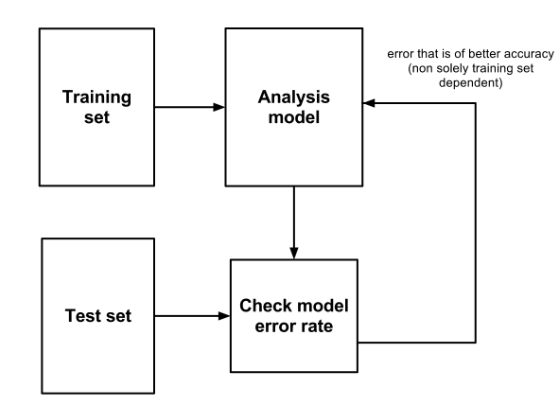
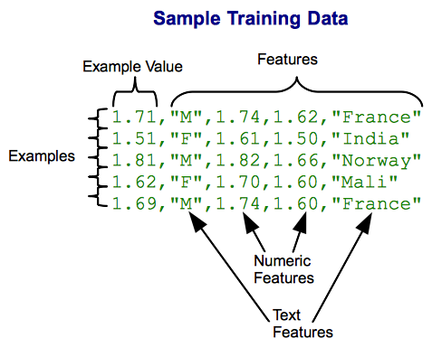
Training set

Slide 9
Classification vs Regression
Regression Learn a function mapping an input element to a real value. i.e: Predict the temperature of tomorrow given some meteo signals
Classification Learn a function mapping an input element to a class (within a finite set of possible classes).
i.e: Predict the weather of tomorrow: {sunny, cloudy, rainy} given some meteo signals

Slide 10
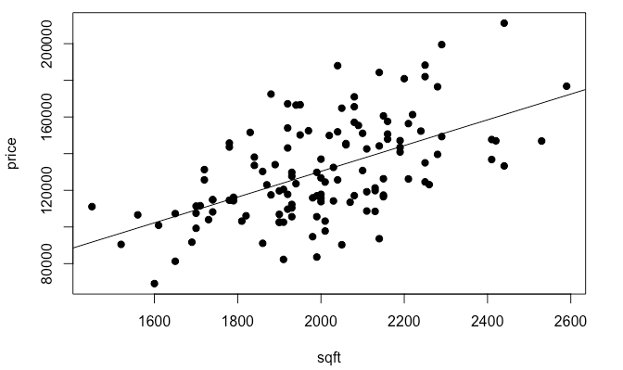
Regression

Slide 11
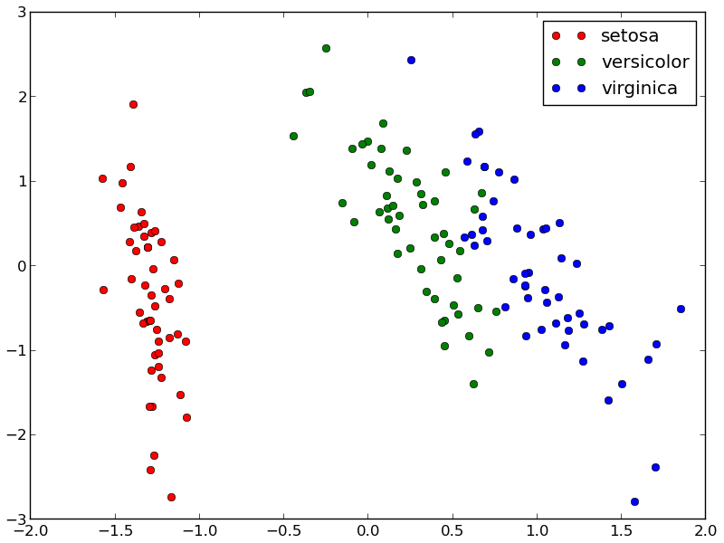
Classification
Illustration: scikit-learn documentation

Slide 12
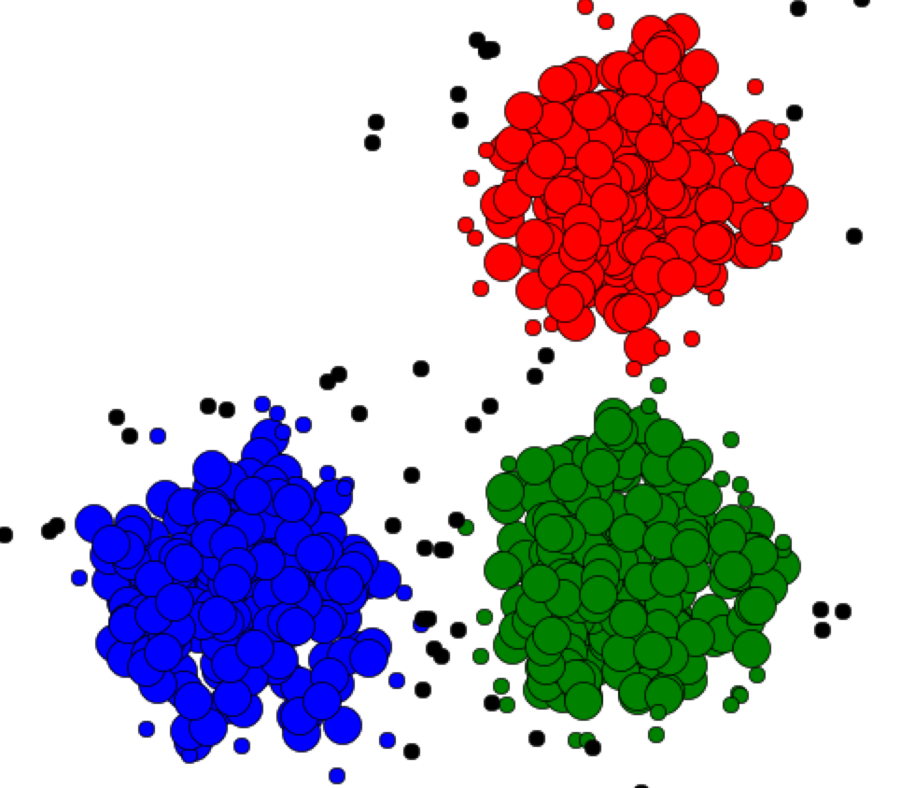
Clustering
A clustering algorithm separate different observed data points in similar groups (clusters). We do not know the labels during training.
Cluster 1
Cluster 3
Cluster 2
Illustration: Rana Forsati

Slide 13
Reinforcement learning
Learn the optimal behavior for an agent in an environment to maximize a given goal.
Examples:
Drive a car on a road and minimize the collision risk
Play video-games
Choose the position of ads on a website to maximize the number of clicks

Slide 14
Feature extraction
The first step in a machine learning process is to extract useful values from the data (called features).
The goal is to extract the information useful for the task we want to learn.
Examples:
Stock market time-serie → [opening price, closing price, lowest, highest]
Image → Image with edges filtered
Document → bag-of-word

Slide 15
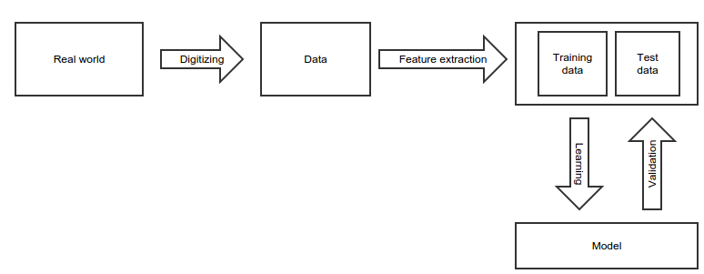
Modelisation process

Slide 16
k nearest neighbors

Slide 17
k-nearest neighbors
Classification and regression model
Supervised learning: we have annotated examples
We classify a new example based on the labels of his “nearest neighbors”
k is the number of neighbors taken in consideration

Slide 18
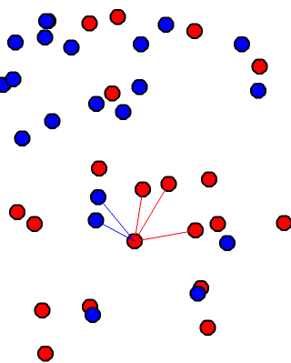
k-nearest neighbors
To classify a point:
We look the k-nearest neighbors (here k=5) and we do a majority vote.
This point has 3 red neighbors and 2 blue neighbors, it will be classified as red.

Slide 19
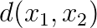
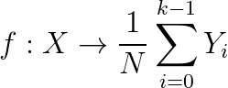
k-nearest neighbors
N data points
Require a distance function between points
Regression (average the value of the k-nearest neighbors)
Classification (majority vote of the k-nearest neighbors)

Slide 20
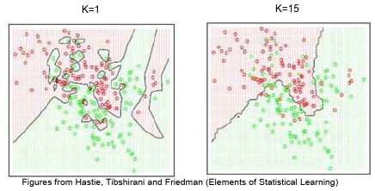
k-nearest neighbors : effect of k
k is the number of neighbors taken in consideration
If k = 1
The accuracy on the training set is 100%
It might not generalize on new data
If k > 1
The accuracy on the training set might not be 100%
It might generalize better on unseen data

Slide 21
k-nearest neighbors : weighted version
In the case of unbalanced repartition between classes we can give weights to the examples.
The weight of a under represented class will be set high.
The weight of a over represented class will be set low.
When we do the majority vote, we take the weight in consideration:
For classification we do a weighted vote.
For regression we do a weighted average.

Slide 22
Decision trees, random forests

Slide 23
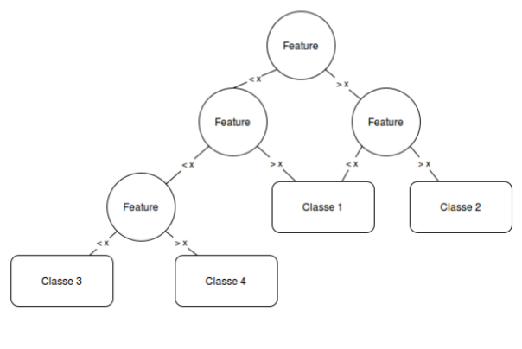
Decision tree

Slide 24
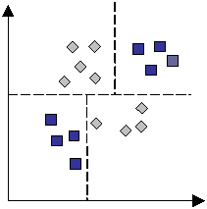
Decision tree
Decision trees partition the feature space by splitting the data
Learning the decision tree consists in finding the order and the split criterion for each node

Slide 25
Decision tree
The decision tree learning is parametrized by the method for choosing the splits and the maximum height
If the maximum height is big enough, all the examples of the training data would be correctly classified: overfitting.

Slide 26
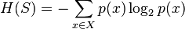
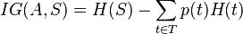
Decision tree : entropy metric
Entropy:
S: The datasets before the split
X: Set of existing classes
p(x): Proportion of elements in class x to the number of elements in S
A: The split criterion
T: The datasets created by the split
At each step we create the node by splitting with the criterion with the highest information gain.

Slide 27
Random forests
When the depth of a decision tree is growing the error on validation data tends to increase a lot: high variance
One way to exploit a lot of data is to train multiple decision trees and average them
Algorithm:
Select N points in the training data and k features (usually sqrt(p))
Learn a new decision tree
Stop when we have enough trees

Slide 28
Clustering - k means

Slide 29
Clustering with k-means
Clustering algorithm
Require a distance function between points
k is the number of cluster the algorithm will find

Slide 30
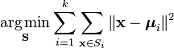
Clustering with k-means
Objective: Divide the dataset in k sets by minimizing the within-cluster sum of squares (sum of distances of each point of the cluster to the center of the cluster)
Where S are the sets we are learning and μ_{i} the mean of the set i.

Slide 31
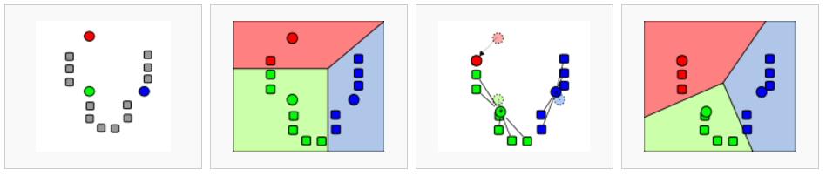
Clustering with k-means
Illustration: Wikipedia, k-means

Slide 32
Gradient descent

Slide 33
Gradient descent
Define a model depending on W (the parameters of the model)
Define a loss function that quantify the error the model does on the training data
Compute the gradient of this loss
Adjust W to minimize the loss by following the direction of the computed gradient
Repeat until:
convergence
the model is good enough
your spent all your money

Slide 34
Linear regression

Slide 35
Linear regression : Introduction
In supervised learning, we have examples of lots of input and the desired output value.
This is called the dataset:
A matrix of feature vectors X. Each line is an vector containing an example*.
A vector of target values Y. The kth component is the desired value for the kth example of X.
* : For simplification, the first element x0 = 1.

Slide 36
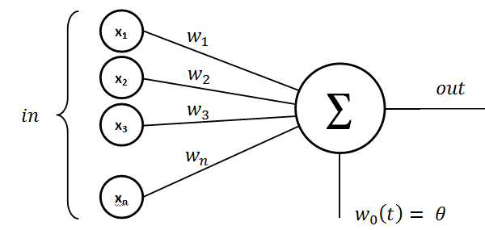
Linear model

Slide 37
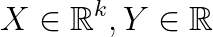
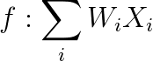
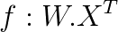
Linear regression
Let say we extracted a real valued vector of features : X
We want to learn a linear relation between this features and an output value : Y
W is called weight vector, it is the parameter of the model. Here we learn the function f by adjusting W.
(also)

Slide 38
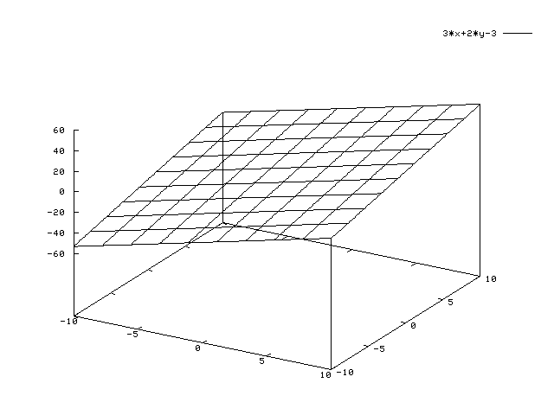
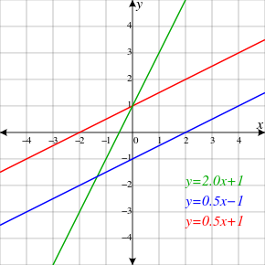
Linear regression
With an input of dimension 1, the equation is:
x1 is the input value and w1 is the slope of the linear function
We set x0 = 1 so f(0) = w0
It generalize in higher dimension by multiplying each coordinate of the input by its respective weight.
By adjusting W we can define any hyperplane mapping the input vector to the output value.
The model can be viewed as a line, adjusted by W, mapping the input value to the output value.

Slide 39
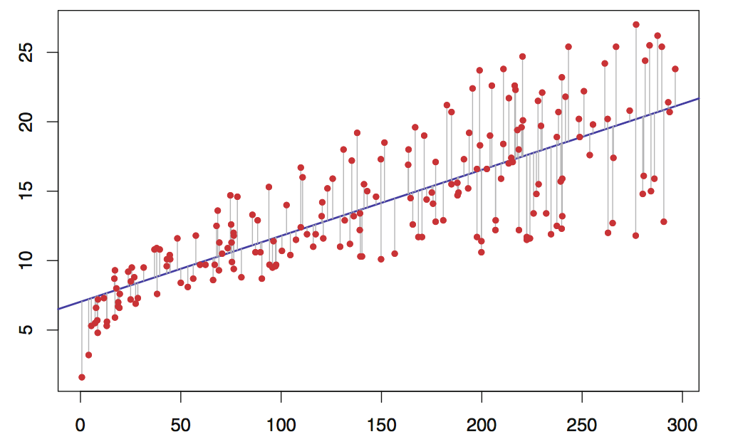
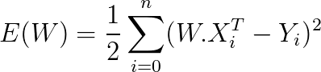
Linear regression : error function
We define a function E(W) which quantify the error we observe on the examples. i.e: Euclidean distance between the target and f(X)

Slide 40
Linear regression : error function
We can define the error by using the sum of squared distances between expected targets and the values given by the model:
The training error only depends of W, the dataset is constant during the training.
Problem: Minimize the error by adjusting W (i.e: find the best W such as E is the lowest as possible).

Slide 41
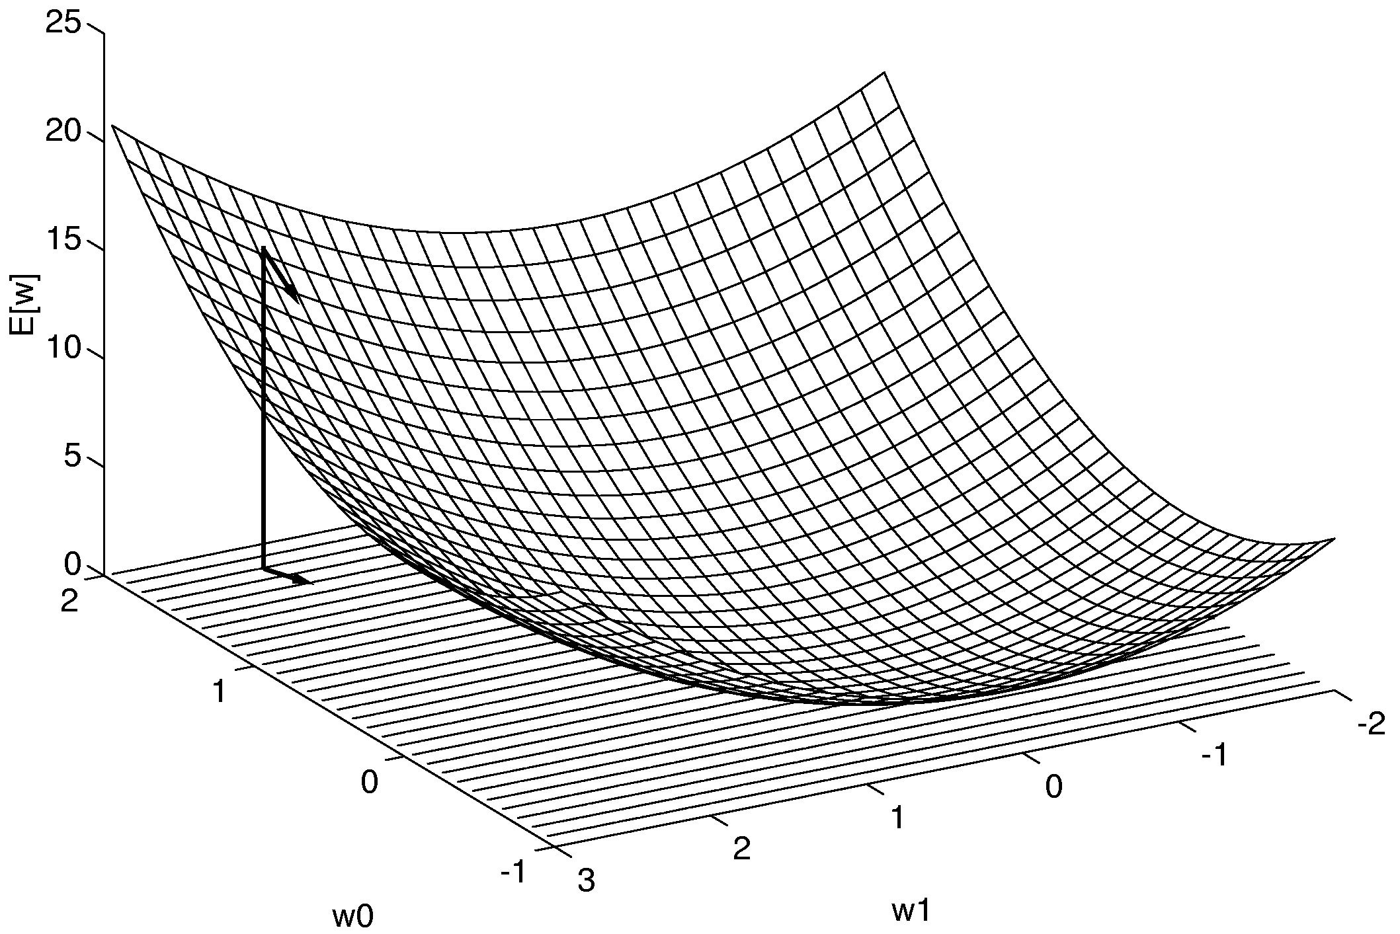
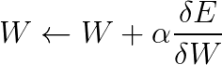
Linear regression : gradient descent
The least squared loss of a linear model is a convex function (“bowl-shaped”)
One simple way to find its minimum is by following the slope of the error.
Illustration: Tom Mitchell, McGraw-Hill

Slide 42
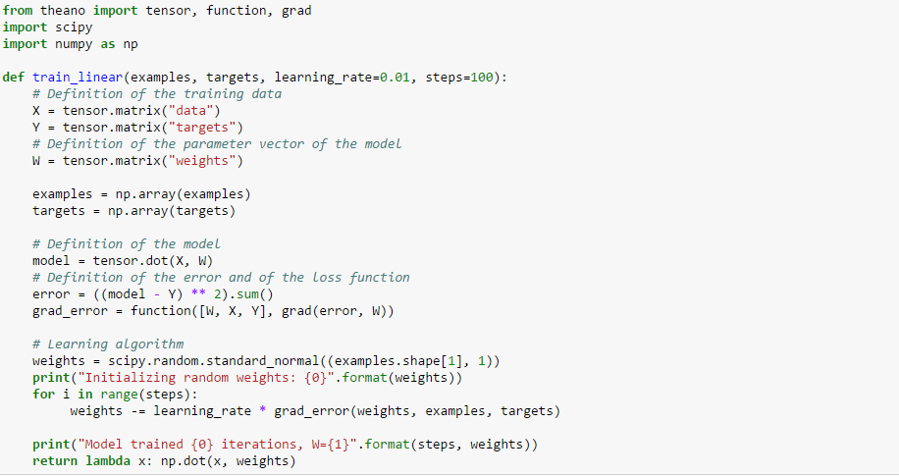
Linear regression : implementation
ipython notebook:

Slide 43
Perceptron

Slide 44
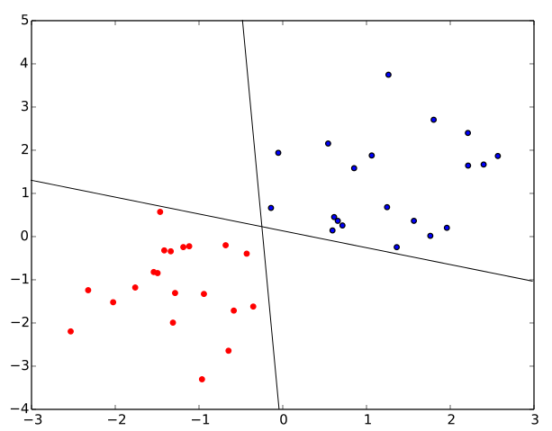
Perceptron : binary classifier
We saw how to learn a linear mapping between input values and targets.
Let’s see a close method for classification: the perceptron.
Learn an hyperplane to separate two class of data-points.
Illustration: Wikipedia, perceptron

Slide 45
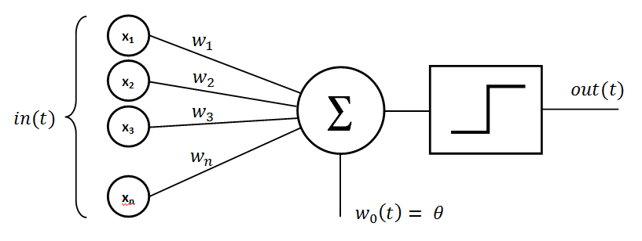
Perceptron : binary classifier
Illustration: Wikipedia, perceptron

Slide 46
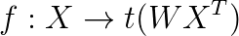
Perceptron : binary classifier
We learn the parameters W of the function f:
Where t is a transfer function Example: The step function
t(x) = 1 if x > 0
t(x) = -1 otherwise
If the data point is above the hyperplane then it is a member of the class, otherwise it is not.

Slide 47
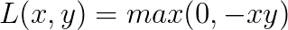
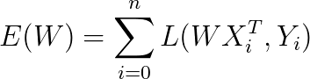
Perceptron : loss function
We can define the error of the perceptron by the number of elements it correctly classify… But this is a hard problem to optimize.
We use instead a loss function that we will minimize for each example.
One commonly used is:
The error function to minimize (by adjusting W) is:
Notes:
Connect with hinge loss

Slide 48
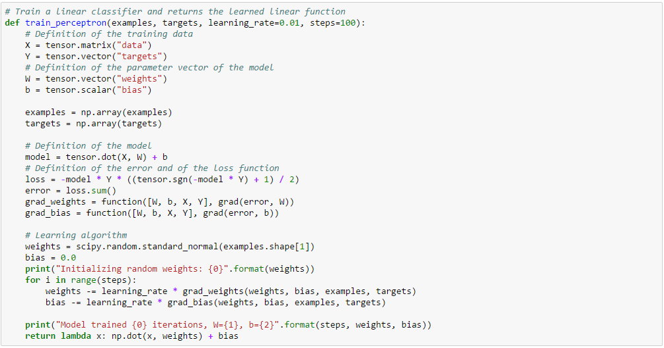

Slide 49
Principal component analysis

Slide 50
Principal component analysis
Motivation: Find a linear projection of the features of the dataset to reduce the dimensionality or attenuate the noise.
Method:
Find new orthogonal components by maximizing the variance over each component
It is also the set of orthogonal components which minimize the projection distance

Slide 51
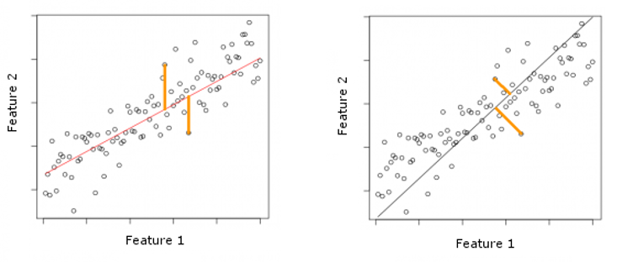
Principal component analysis
Linear regression
PCA
Illustration : Stack Exchange

Slide 52
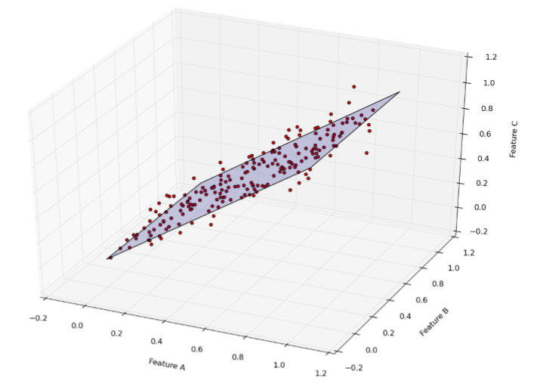
Principal component analysis

Slide 53
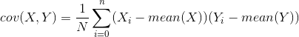
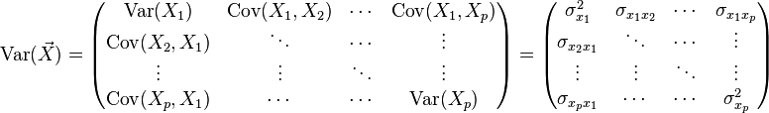
Principal component analysis : covariance matrix
X and Y are two columns of the training set, each containing the value of one feature for all the examples.
Covariance matrix:

Slide 54
Principal component analysis : algorithm
Normalize the dataset
Compute the covariance matrix
Compute the eigenvectors and eigenvalues of the covariance matrix
Sort the eigenvectors by eigenvalues
Build a matrix B with the k first eigenvectors (one per row)
Project the dataset with p(x) = BX

Slide 55
Support vector machine
And the kernel trick

Slide 56
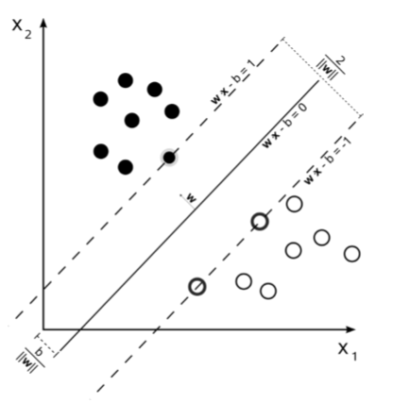
Support vector machine
Objective: Find the hyperplane with the biggest margin separating two classes.
Illustration: Wikipedia, SVM

Slide 57
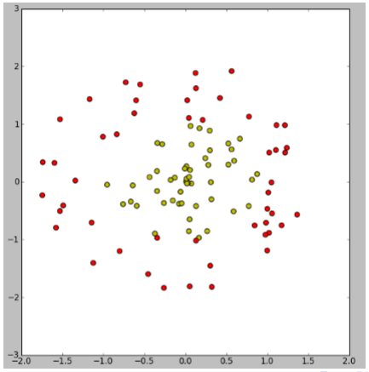
Support vector machine : nonlinear case

Slide 58
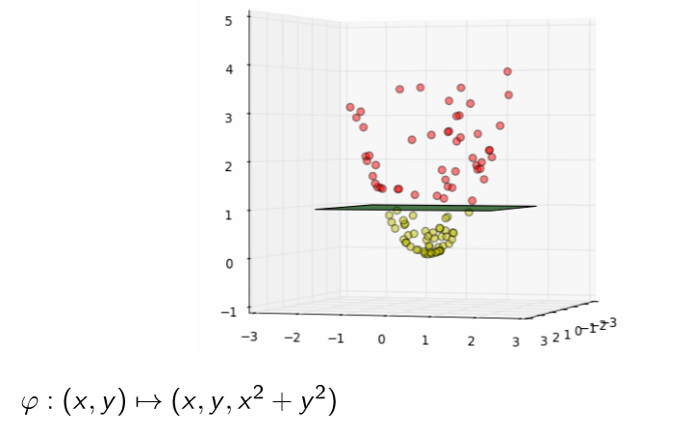
Kernel trick

Slide 59
Kernel trick
Some algorithms only require the dot product between 2 vectors
Instead of computing by:
projecting in a higher dimensional space
compute the dot product
We can use the kernel trick:
There exists some functions (Mercer’s condition) which are cheap to compute and can be expressed as a dot product in a higher dimensional space.

Slide 60
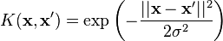
Kernel trick
Polynomial kernel
RBF kernel

Slide 61
Bias and variance

Slide 62
Bias and variance
When applying a ML algorithm, we do some assumptions to learn the model:
k-nn: neighborhood influence
linear model: linear mapping between input and output, loss function
perceptron: we can separate the data linearly, loss function
SVM: kernel type, hyperparameters
Those assumptions will influence the bias and the variance of the model

Slide 63
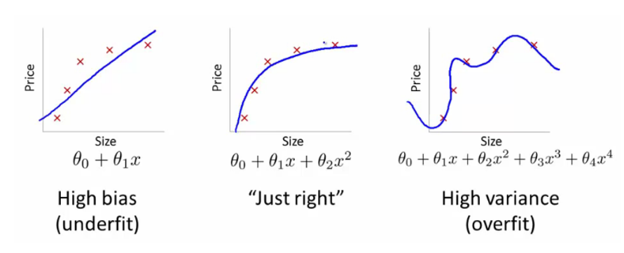
Bias and variance
Illustration: Andrew Ng

Slide 64
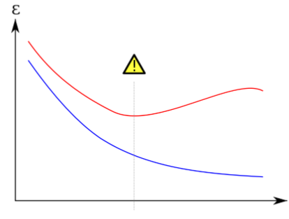
Bias variance
Big error (underfitting):
High bias
Low variance
Good tradeoff
Big error rate (overfitting):
Low bias
High variance
High bias
Low bias

Slide 65
Neural networks
(Multilayer perceptron)

Slide 66
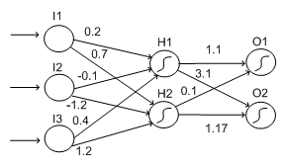
Neural networks
From the perceptron seen previously we can build a multilayer perceptron
By chaining multiple non-linear function we allow the model to learn more complex relationships between input and output.

Slide 67
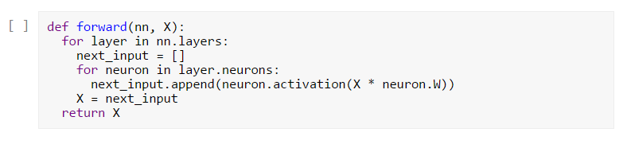
Neural network : forward pass
The forward pass consists in evaluating the output of the neural network.
It compute the output from the first layer to the last layer.

Slide 68
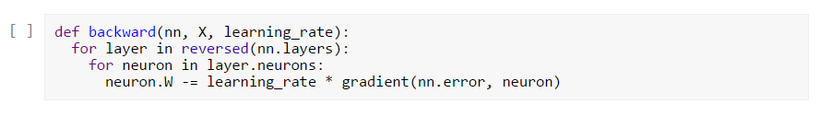
Neural networks : backward pass
We can compute easily the gradient of the error with respect to the weight of the last layer
The gradient of the error with respect to the weight of the others layers are computable by applying the chain rule :

Slide 69
Neural network : matrix optimization
It is possible to see the neural network as multiple matrix operations by considering each layer as a matrix of weights.
It simplify the algorithm and it’s way faster at training time!
Hardware optimization
Can be executed on GPU

Slide 70


Slide 71
Deep learning
A gentle introduction

Slide 72


Autoencoders
Learn the identity function (unsupervised learning)
The data is compressed then reconstructed
The hidden layer is called bottleneck
It contains an “embedding” of the input
Illustration: Stack exchange

Slide 73

Shallow VS deep networks

Slide 74
Deep learning : convolutional neural network
High resolution images contains O(millions) of pixels
A neural network which can handle that kind of images would also have O(millions) of weight
Solution: Repeat the same part of the network over the whole image area

Slide 75

Deep learning : convolutional filter
Example: Edge detection

Slide 76

Deep learning : convolutional neural network
Illustration: Theano documentation
This kind of architecture will learn filters and build an internal representation of the input data using many stacked layers and finally use this representation on a classification task.

Slide 77


Learn high level features of a cat
Training: 16.000 CPU during 3 days
Learned high levels features of cats, human faces by watching Youtube videos
Totally unsupervised : unlabeled data
“Best neuron” activation heat map
Building High-level Features Using Large Scale Unsupervised Learning
Quoc Le, Marc'Aurelio Ranzato, Rajat Monga, Matthieu Devin, Kai Chen, Greg Corrado, Jeff Dean, Andrew Ng

Slide 78


Deep learning : convolutional neural networks
ImageNet Classification with Deep Convolutional Neural Networks Alex Krizhevsky, Ilya Sutskever, Geoffrey E. Hinton
The model learns some edge detection filter. We find a similar process in the cells of the primary visual cortex of the human brain
Edge detectors filters :

Slide 79

Word embedding models

Slide 80

Word2vec : distance metric
Nearest neighbors of “France” :
The model learn embeddings (a float vector) to represent words such as two words close in the semantic space are close in the embedding space
Cosine distance (~ L2 distance when vectors are normalized)
word2vec - https://code.google.com/p/word2vec/

Slide 81

Word2vec : PCA data visualisation

Slide 82

ImageNet challenge
Visit : http://www.image-net.org
Detection and classification of images over 1000 different classes
Deep learning leads to a breakthrough in prediction quality
GoogleNet is the architecture who won the challenge in 2014

Slide 83


ImageNet : Humans vs Machine
ImageNet Large Scale Visual Recognition Challenge
arXiv:1409.0575 - Olga Russakovsky, Jia Deng et al.

Slide 84

Image description : conv-nn + LSTM
Show and Tell: A Neural Image Caption Generator
arXiv:1411.4555 - Oriol Vinyals, Alexander Toshev, Samy Bengio, Dumitru Erhan

Slide 85

Image description : conv-nn + LSTM
Show and Tell: A Neural Image Caption Generator
arXiv:1411.4555 - Oriol Vinyals, Alexander Toshev, Samy Bengio, Dumitru Erhan

